Slide 1
ADVOCACY IN ACTION
Why ACP Services PAC Matters to Chapters, Internists, and Patients
Sue S. Bornstein, MD, FACP
September 30, 2022
ACP Board of Governors Meeting

Slide 2

The Mission of ACP Services Political Action Committee (PAC)
The PAC is housed under ACP Services, Inc. – a 501(c)6 organization that is a separate organization from ACP.
This is done for legal reasons because ACP, as a 501(c)3 organization, cannot operate a PAC or otherwise engage in political activity or advocacy.
Both ACP and ACP Services can and do advocate for the same policy issues and are comprised of the same membership; ACP Services “PAC” membership is a separate voluntary contribution.
ACP Services, through its PAC, can go beyond what ACP can legally do by advocating in the political arena and helping to elect internist-friendly candidates to the U.S. Congress.
ACP Services PAC is B-I-P-A-R-T-I-S-A-N!

Slide 3

ACP Services PAC’s Mission
The PAC is an advocacy tool to collectively pool funds from our members to contribute to candidates for the U.S. House and Senate whose views (on policy issues) are aligned with the College.
The PAC is federally regulated and a transparent way to collectively support candidates.
Contributions from the PAC to candidates/members of Congress are carefully vetted through ACP Services PAC Board.
The PAC is the strongest way for us to be at the table with members of Congress.
Helps elect internists and other physicians to Congress; Example - Rep. Ami Bera (D-CA), Rep. John Joyce (R-PA), both ACP members.

Slide 4
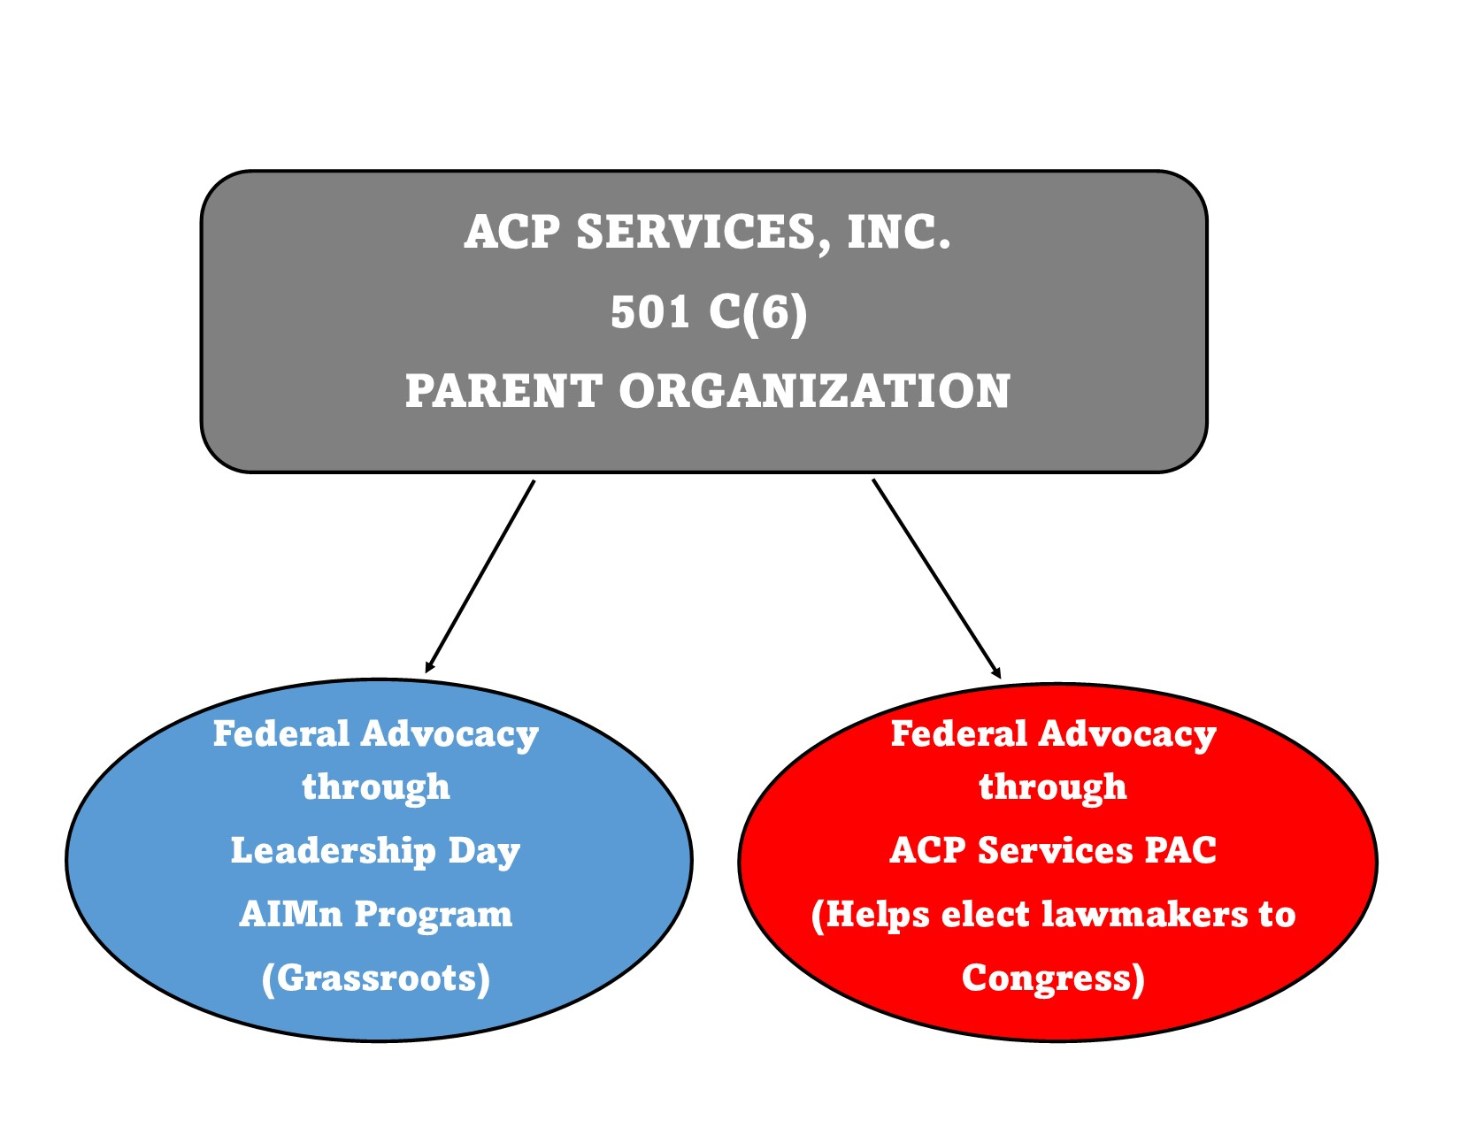
How ACP Services PAC supports
ACP Services

Slide 5

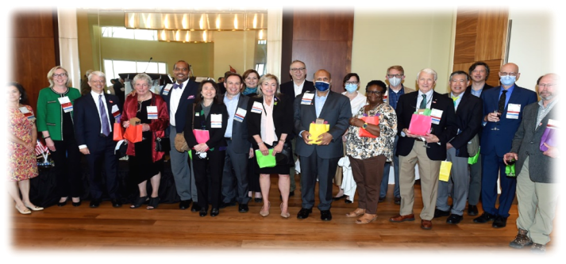
ACP Services PAC Member Benefits
The PAC gives you direct access to your members of Congress in your
home state.
You get to represent the PAC and build relationships with your lawmakers, gain
access to policy briefings and PAC-sponsored events.
The PAC also plays a key role in ACP Services flagship advocacy event, Leadership Day, which is typically held every in May in Washington, DC.

Slide 6

ACP Services PAC’s Goal for the 2022 Elections
Electing/supporting those candidates/incumbents for Congress who will address critical policy issues important to internal medicine and its subspecialties.
Influencing the positions those lawmakers take on those very issues.
Dr. Gill & Dr. Meyer with Representative Ami Bera (D-CA)

Slide 7
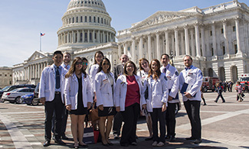

ACP Services PAC is fighting for:
Affordable, accessible, quality health coverage for ALL
Payment policies to support the value of care provided by internal medicine physicians
Coverage and payment for telehealth
Access to reproductive health care
Prescription drug reform – reduced pricing, greater transparency
Funding for federal workforce programs to train more internal medicine physicians
Diversity, equity, and inclusion – addressing health care disparities
Climate change mitigation
Reducing incidents of firearms-related injury and death
Access to mental and behavioral health services

Slide 8

How You Can Help
ACP’s Governors can discuss the PAC and its activities in “conjunction” with your chapter meetings, as long as you follow a set of guidelines; we encourage you to do this.
ACP chapters are c3 entities so, for legal reasons and to protect your chapter’s c3 status, you must adjourn your chapter meeting and then reconvene as a meeting of ACP Services – just as we are doing by example here today.
A toolkit is posted on the PAC website – outlines all you need to know. We make it easy!
https://www.acpservices.org/pac/resources/toolkit-materials-discussions-acp-chapter-meetings

Slide 9

How can ACP’s Governors/Chapters support the PAC?
Get involved; join the PAC; lead by example.
Your participation in the PAC signals to your chapter members the importance of the PAC as an advocacy tool.
Convene a meeting of ACP Services in conjunction with your chapter meetings to discuss the PAC.
Goal is to have 100% of ACP’s leadership (U.S.) as PAC members; Regents/Governors/Governors-Elect.

Slide 10

ACP Leadership Participation in the PAC:
Where We Stand
  As of 9/12/22:
  Governors-elect (U.S.) – 2 PAC members, 10% participation rate
  Governors (U.S.) - 34 PAC members, 51% participation rate
  Regents - 21 PAC members, 87% participation rate
  There is strength in numbers. We can do better!

Slide 11

Questions About the PAC or Getting Involved?
To make a contribution to ACP Services PAC:
https://www.acpservices.org/pac/
Jessica Davis Greg Rovick
Director, ACP Services PAC Administrator, ACP Services PAC
jessica@jrdstrategic.com grovick@acponline.org
Jonni McCrann
Executive Vice President, ACP Services, Inc.
jmccrann@acponline.org

