Slide 1
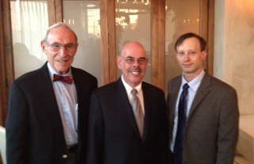
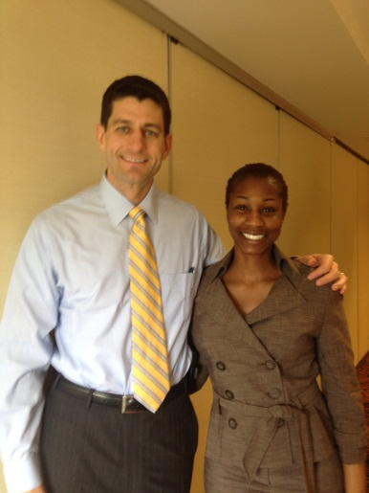
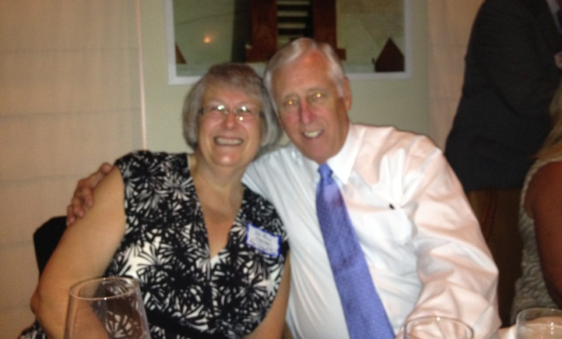
Understanding ACP Services PAC
And How You Can Help
Make A Difference

Slide 2
What’s a PAC?
A Political Action Committee (PAC) is an entity permitted under federal law to make contributions to political candidates running for office at the state and/or federal level.
As an IRS 501(c)(6) organization, ACP Services is allowed to engage in political activity and discussion through its PAC.
In 2004, ACP Services PAC was formed to help promote Internists' participation in the political process.
LR: 2-2013

Slide 3
Understanding ACP Services PAC
Because corporations, like ACP Services, cannot donate to campaigns, the PAC allows ACP Services’ members to pool their personal financial resources to support candidates who are inclined to support ACP Services’ agenda.
All dues-paying and/or voting members of ACP Services who are U.S. citizens or legal U.S. residents may be solicited and are invited to attend the ACP Services meeting to discuss the PAC.
LR: 2-2013

Slide 4
Why Having a PAC is Important
Provides an effective avenue for ACP Services members to be politically active;
Increases access to members of Congress;
Raises the visibility of ACP Services;
Gives PAC members the opportunity to participate in fundraising events in their area, providing an increased opportunity for face-to-face access to candidates supported by the PAC.
LR: 2-2013

Slide 5
How ACP Services PAC Works
The PAC targets its contributions to candidates who are in a position to shape health care policy and who have a track record of support on issues of concern to internists and their patients, such as those who sit on the following committees:
House Ways & Means
House Energy & Commerce
Senate Finance
Senate Health, Education, Labor & Pensions
House and Senate Appropriations
LR: 2-2013

Slide 6
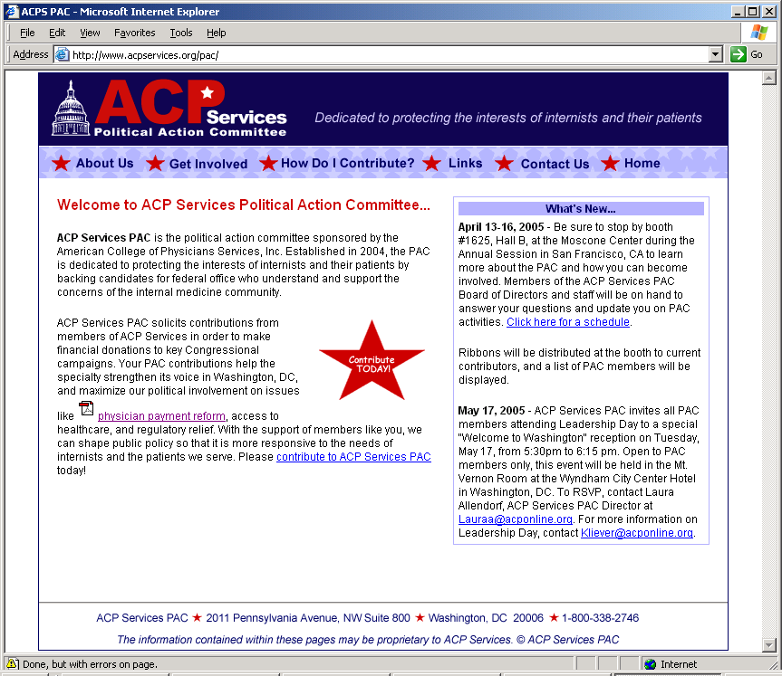
PAC Web site www.acpservices.org/pac
LR: 2-2013

Slide 7
How Do I Contribute?
Via personal check payable to “ACP Services PAC”
Online via personal credit card
www.acpservices.org/pac
Cash contribution of $100 or less
We in America do not have government by the majority.
We have government by the majority who participate.
--Thomas Jefferson
LR: 2-2013

Slide 8
Help Us Grow - Size Matters
LR: 2-2013

